Slide 1
Operating System 7

Slide 2
Introduction
CPU can be shared by a set of processes.
With CPU scheduling, we can improve both the utilization of the CPU and the speed of the computer’s response to its users.
To realize this increase in performance, however, we must keep several processes in memory—that is, we must share memory

Slide 3
Memory Management
Subdividing memory to accommodate multiple processes
Memory needs to be allocated to ensure a reasonable supply of ready processes to consume available processor time
Relocation
Programmer does not know where the program will be placed in memory when it is executed
While the program is executing, it may be swapped to disk and returned to main memory at a different location (relocated)

Slide 4
Cont…
Protection
Processes should not be able to reference memory locations in another process without permission
Impossible to check absolute addresses at compile time
Must be checked at run time
Memory protection requirement must be satisfied by the processor (hardware) rather than the operating system (software)
Operating system cannot anticipate all of the memory references a program will make
Sharing
Allow several processes to access the same portion of memory
Better to allow each process access to the same copy of the program rather than have their own separate copy

Slide 5
Fixed-Sized Partition: In the fixed-sized partition, the memory is divided into fixed-sized blocks and each block contains exactly one process. But, the fixed-sized partition will limit the degree of multiprogramming as the number of the partition will decide the number of processes.
Variable-Size Partition: In the variable size partition method, the operating system maintains a table that contains the information about all memory parts that are occupied by the processes and all memory parts that are still available for the processes.

Slide 6
Fixed Partitioning
Equal-size partitions
Any process whose size is less than or equal to the partition size can be loaded into an available partition
If all partitions are full, the operating system can swap a process out of a partition
A program may not fit in a partition. The programmer must design the program with overlays
Main memory use is inefficient. Any program, no matter how small, occupies an entire partition. This is called internal fragmentation.

Slide 7
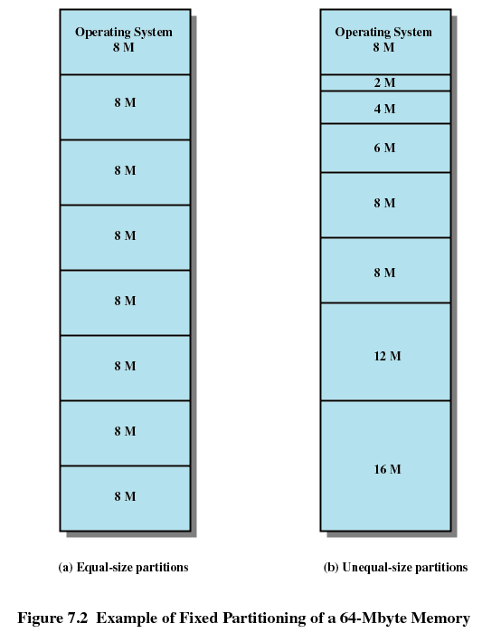
Cont…

Slide 8
Memory Allocation
The main memory has to accommodate both the operating system and user space.
Now, here the user space has to accommodate various user processes.
We also want these several user processes must reside in the main memory at the same time.

Slide 9
Contiguous Memory Allocation
In Contiguous memory allocation, when the process arrives from the ready queue to the main memory for execution, the contiguous memory blocks are allocated to the process according to its requirement.
Now, to allocate the contiguous space to user processes, the memory can be divide either in the fixed-sized partition or in the variable-sized partition.

Slide 10
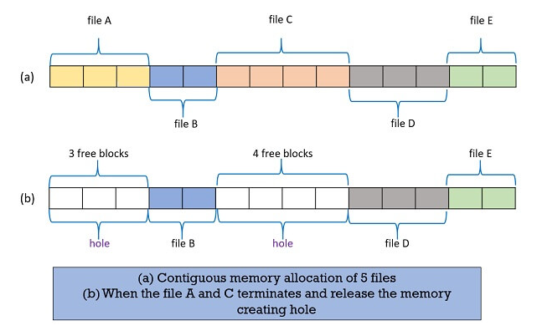

Slide 11
Cont…
Initially, the whole memory space is available for the user processes as a large block, a hole.
Eventually, when the processes arrive in the memory, executes, terminates and leaves the memory it creates set of holes of variable sizes
In the variable size partition method, the operating system analysis the memory requirement of the process and see whether it has a memory block of the required size.
If it finds the match, then it allocates that memory block to the process.
If not, then it searches the ready queue for the process that has a smaller memory requirement

Slide 12
Fragmentation
Internal Fragmentation – allocated memory may be slightly larger than requested memory; this size difference is the memory internal to a partition, that is not being used.
External Fragmentation – total memory space exists to satisfy a size n request, but that memory is not contiguous.

Slide 13
Reduce external fragmentation by doing compaction:
Shuffle memory contents to place all free memory together in one large block (or possibly a few large ones).
Compaction is possible only if relocation is dynamic, and is done at execution time.

Slide 14
Placement Algorithms
Operating system must decide which free block to allocate to a process
Best-fit algorithm
Chooses the block that is closest in size to the request
Since smallest block is found for process, the smallest amount of fragmentation is left
Memory compaction must be done more often

Slide 15
Cont…
First-fit algorithm
Scans memory form the beginning and chooses the first available block that is large enough
Fastest
May have many process loaded in the front end of memory that must be searched over when trying to find a free block
Worst-fit
Search the entire list of available memory and allocate the largest block.

Slide 16
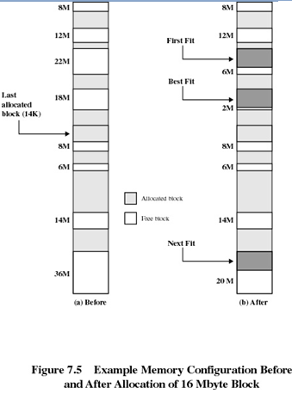
Cont…

Slide 17
Swapping
A process can be swapped temporarily out of memory to a backing store, and then brought back into memory for continued execution
Backing store – fast disk large enough to accommodate copies of all memory images for all users; must provide direct access to these memory images
Major part of swap time is transfer time; total transfer time is directly proportional to the amount of memory swapped
Modified versions of swapping are found on many systems (i.e., UNIX, Linux, and Windows)
System maintains a ready queue of ready-to-run processes which have memory images on disk

Slide 18
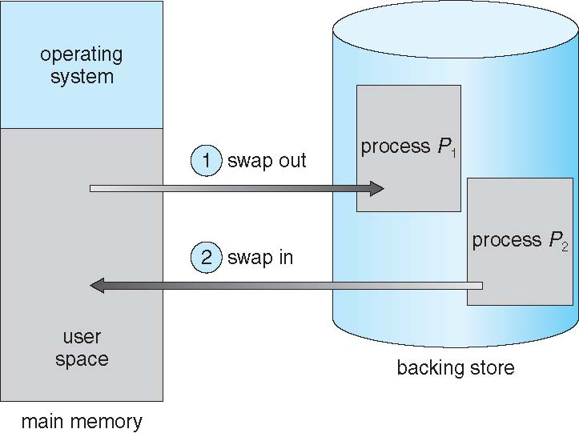
Cont…

Slide 19
Logical Address
Logical Address is generated by CPU while a program is running.
The logical address is virtual address as it does not exist physically, therefore, it is also known as Virtual Address.
This address is used as a reference to access the physical memory location by CPU.
The term Logical Address Space is used for the set of all logical addresses generated by a program’s perspective

Slide 20
Physical Address
Physical Address identifies a physical location of required data in a memory.
The user never directly deals with the physical address but can access by its corresponding logical address.
The user program generates the logical address and thinks that the program is running in this logical address but the program needs physical memory for its execution,
Therefore, the logical address must be mapped to the physical address by MMU before they are used.
The term Physical Address Space is used for all physical addresses corresponding to the logical addresses in a Logical address space

Slide 21
Non Contiguous Memory Allocation
In non-contiguous allocation, Operating system needs to maintain the table which is called Page Table for each process which contains the base address of the each block which is acquired by the process in memory space.
In non-contiguous memory allocation, different parts of a process is allocated different places in Main Memory.

Slide 23
Paging
Paging is a function of memory management where a computer will store and retrieve data from a device's secondary storage to the primary storage.
It is typically stored in random access memory (RAM) for fast retrieval.
Secondary storage is where data in a computer is kept for longer periods of time.
It is a storage mechanism used to retrieve processes from the secondary storage into the main memory in the form of pages

Slide 24
Memory-Management Unit (MMU)
A memory management unit (MMU), sometimes called paged memory management unit (PMMU), is a computer hardware unit having all memory references passed through itself, primarily performing the translation of virtual memory addresses to physical addresses.
Hardware device that maps virtual to physical address
In MMU scheme, the value in the relocation register is added to every address generated by a user process at the time it is sent to memory
The user program deals with logical addresses; it never sees the real physical addresses

Slide 25
Page Table
A page table is the data structure used by a virtual memory system in a computer operating system to store the mapping between virtual addresses and physical addresses

Slide 26
Paging
Divide physical memory into fixed-sized blocks, called frames
Divide logical memory into blocks of the same size, called pages
Keep track of all free frames
To run a program of size n pages, need to find n free frames and load program
Set up a page table to translate logical to physical addresses
Internal fragmentation

Slide 27
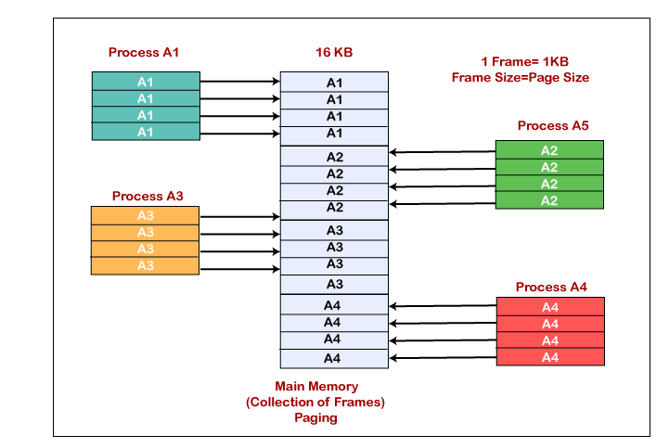

Slide 28
Demand Paging
Demand paging follows that pages should only be brought into memory if the executing process demands them.
This is often referred to as lazy evaluation as only those pages demanded by the process are swapped from secondary storage to main memory.
The page table maps logical memory to physical memory
Demand paging is a type of swapping done in virtual memory systems.
In demand paging, the data is not copied from the disk to the RAM until they are needed or being demanded by some program.
The data will not be copied when the data is already available on the memory.

Slide 29
